Slide 1
Fresh Grads – Group Project
Electricity Payment application

Slide 2
Problem Statement
Online electricity bill payment application is self service facility for view and pay bill online and other related services. This application is aim to remove complete manual process.
Steps need to follow:
1. New user need to sign up (which required only username and password)
2. Fill up customer detail form
3. Apply for new electricity connection
4. Generate bill against reading submitted by customer
5. View or Pay bill
6. If reading not submitted or bill not paid for consecutive two months then susspend connection
Refer https://wss.mahadiscom.in/wss/wss?uiActionName=getHome

Slide 3
Road Map
Application will be developed in following Sprints –
Core Java +JPA with Hibernate
Spring Boot + Rest Controller + JPA with Hibernate

Slide 4
Modules
User Module
Customer Module
Connection
Module
Reading Module
Bill Module
Payment Module

Slide 5
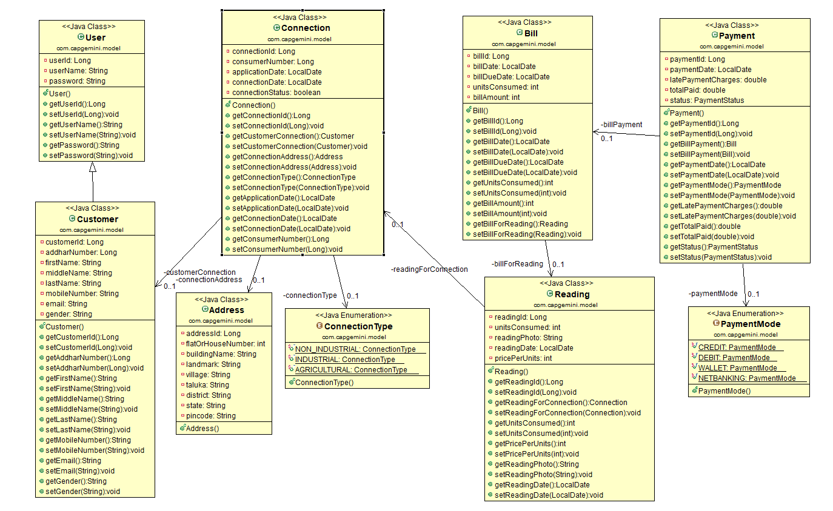
Class Design
POJO Classes:

Slide 6
Class Design
Service Interface

Slide 7
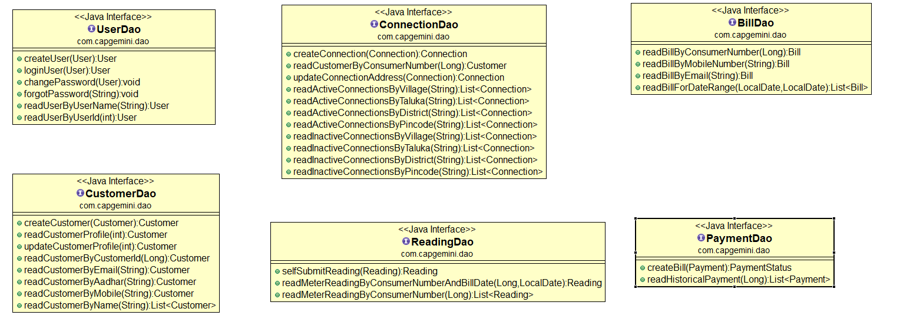
Class Design
Repository:

